Slide 1
A million metaorder analysis of market impact on the Bitcoin
A report by Yu Sun & Hongchao Pan

Slide 2
Data and presenting points
Data
Points
Anonymous source: 13~14M trades with 1M uniquely identified (08/2011-11/2013)
MtGox: 0.6% (60bps) fees per transaction
Claim: Largest and complete market on Bitcoin so far → Pseudo-ramdom metaorders (uncorrelated from the residual order flow)
Long-term power-law decay?
Square-root law?
Y-ratio
Permanent impact?
Notes:
Section 2.1 & 2.2 in the paper
NYSE fees: ~20-30 bps MtGox: 60bps prevent high-frequency arbitrage
V_D: daily volume
Sigma: daily volatility
Y ratio

Slide 3
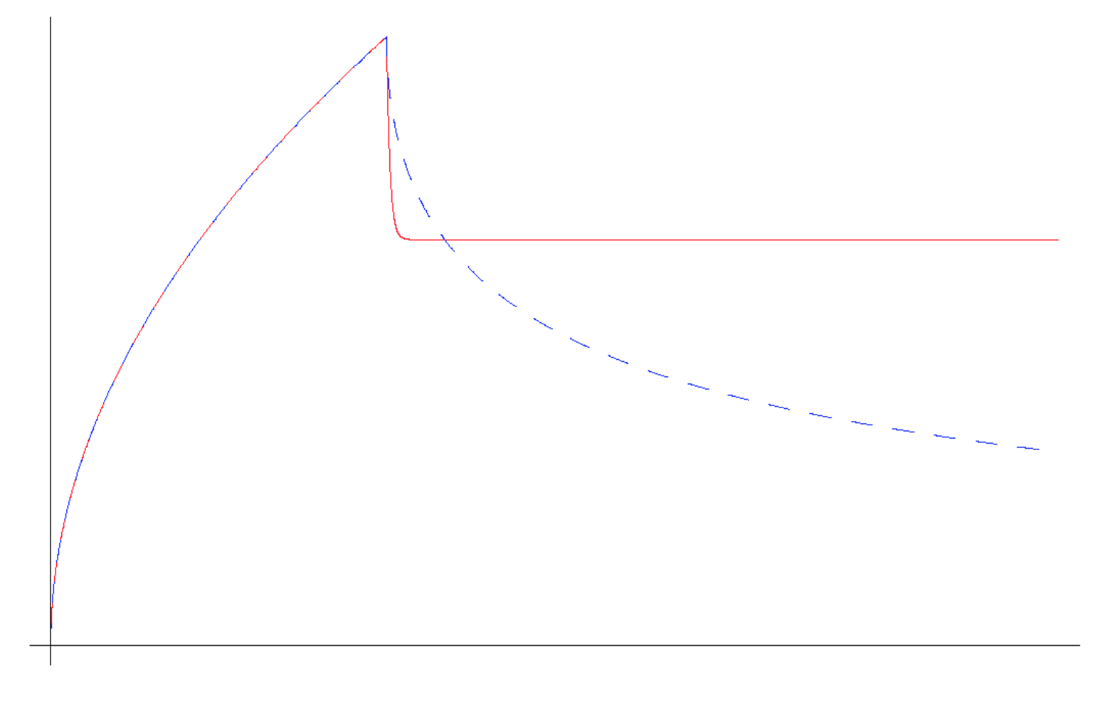
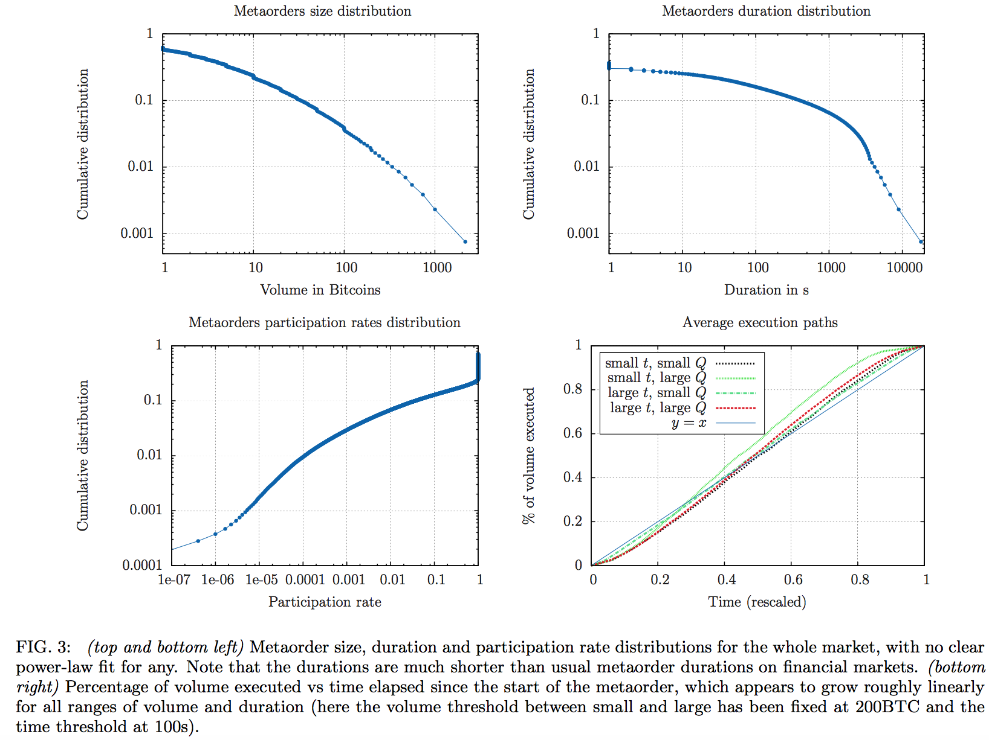
Power-law decay?
Clearly, Metaorder size/duration/participation rate are not power-law decay (FGLW or Bouchaud)
Execution speed is constant
Notes:
Section 3.2 in the paper
Power-law decay: FGLW (left ⅔ permanent impact); Bouchaud (decay with exponent 3/2)

Slide 4
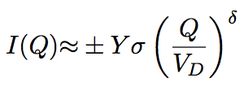

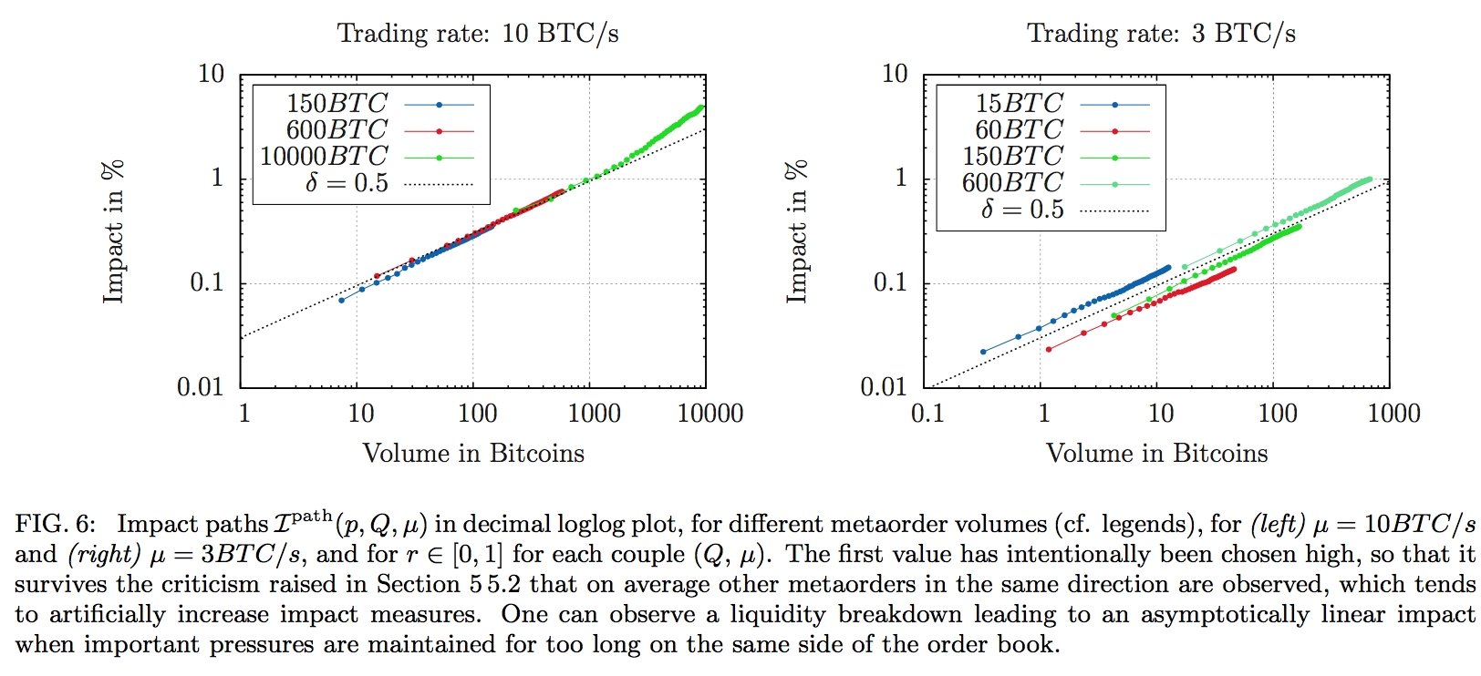
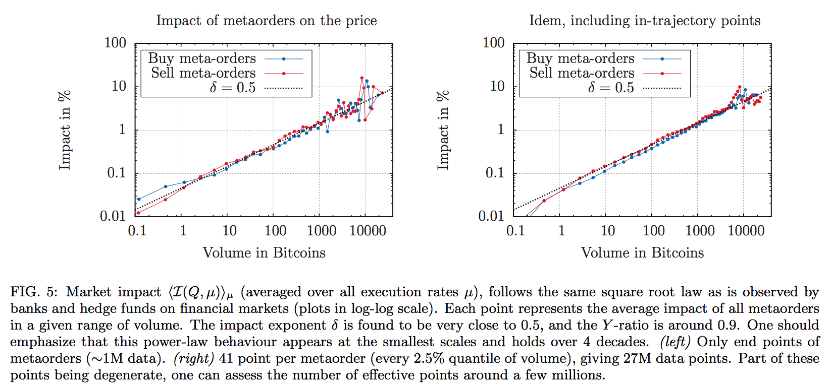
Square-root law?
Execution speed is constant
Peak impact is consistent with square root law
Y-ratio: ~0.9 close to “mature” financial markets
Square root impact trajectories
Brokmann 2014 and Toth 2011a
Notes:
Section 4.1 & 4.2 in the paper
Y: Y-ratio
Sigma: Daily vol
V_D: daily volume
Delta: ~0.5
Square-root impact trajectories: The square root law is clearly confirmed as it even holds trajectory-wise and is exact even at the smallest scales (peak impact)

Slide 5
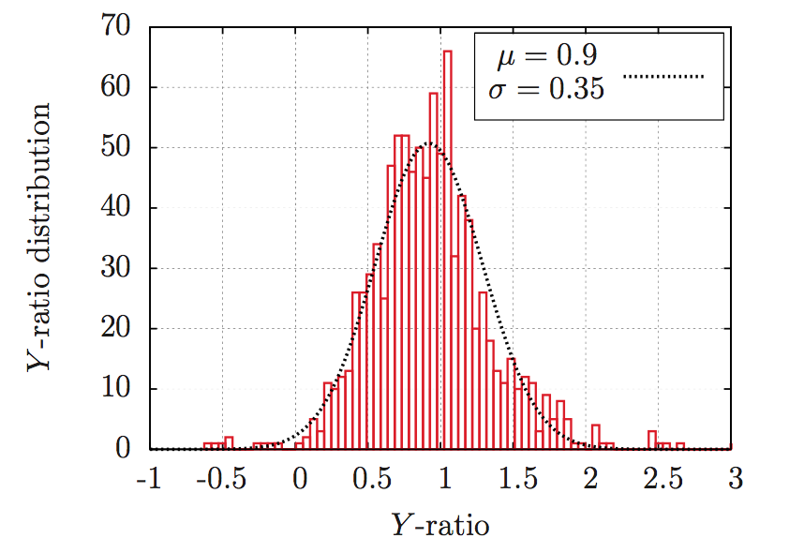
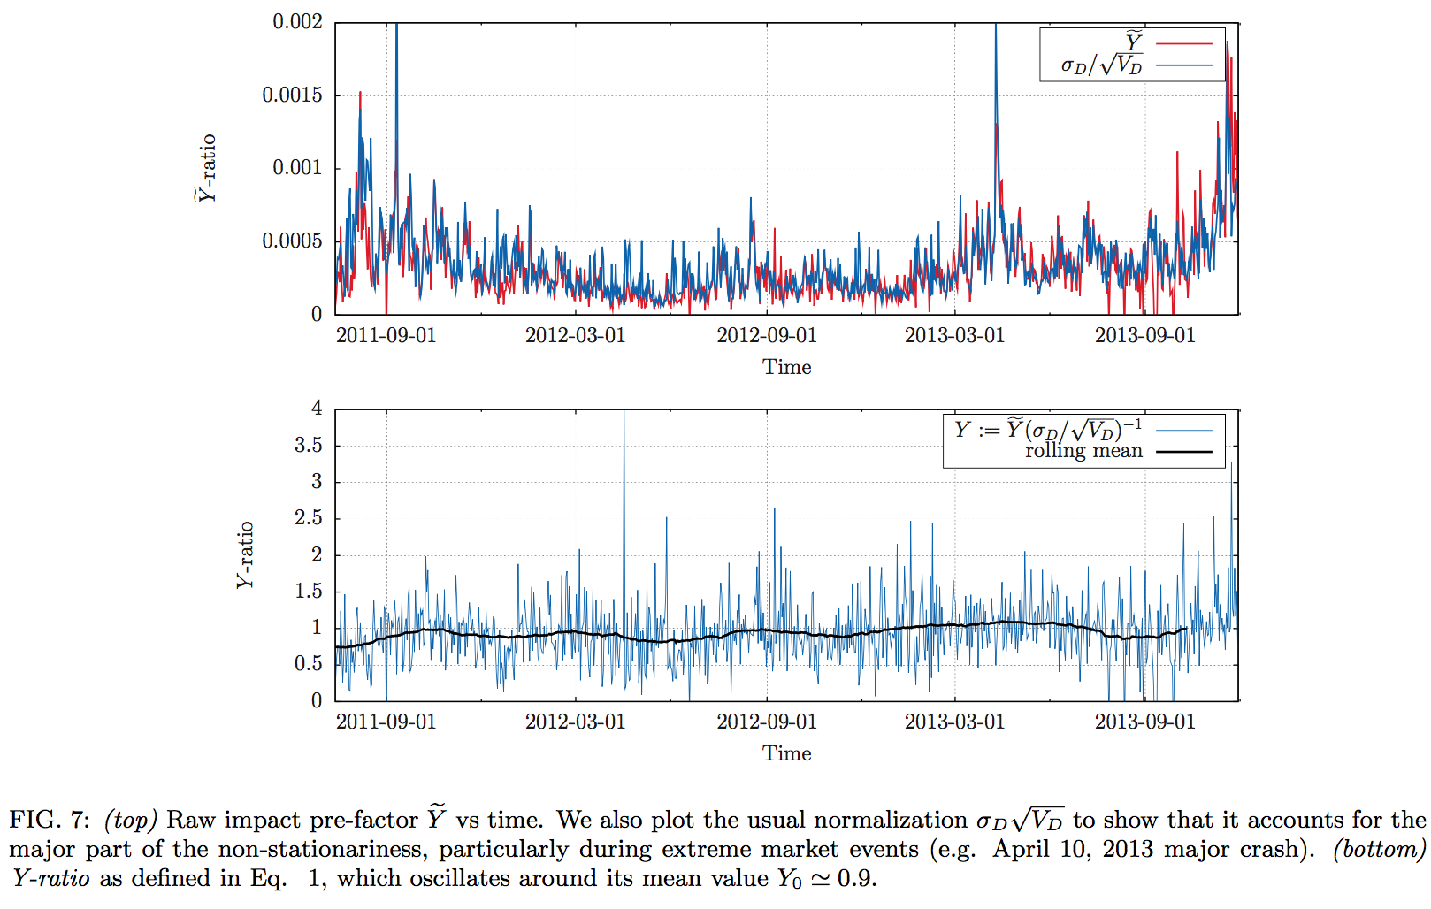

Y-ratio
Less studies on pre-factor or Y-ratio
Pre-factor is well encoded in the ration
Y-ratio is normal distributed
Grinold and Kahn 2000, Torre 1997, and Toth 2011a
Notes:
2nd bullet point validates the citation (3 papers)
Section 4.3 in the paper

Slide 6

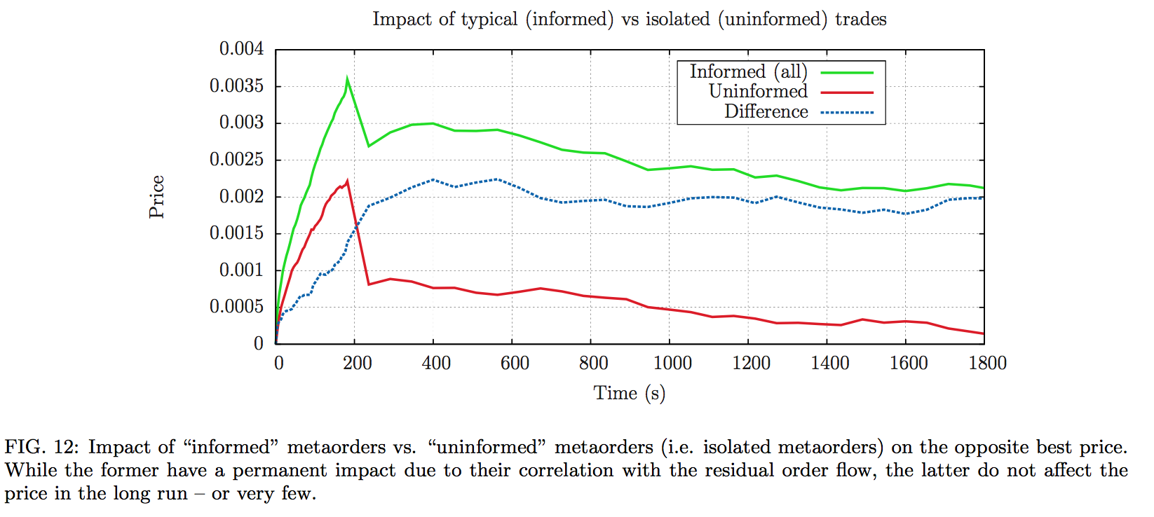
Permanent impact?
Informed: positively correlated to the rest of the market
Uninformed: uncorrelated
Permanent impact of uninformed order is 0 or very small
Mechanical peak impact
Gomes and Waelbroeck 2015
Notes:
Section 5.3 in the paper

Slide 7




Questions?

